Slide 1
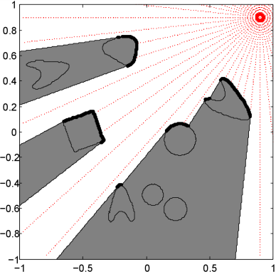
Improbability drive: Entropy-seeking Exploration with* Ising-Model Priors
Josh Hernandez
UCLA Math
Nikos Karianakis
UCLA Computer Science
CV Marathon Meeting,
Sept. 25, 2012
* Excitingly Chunky!

Slide 2
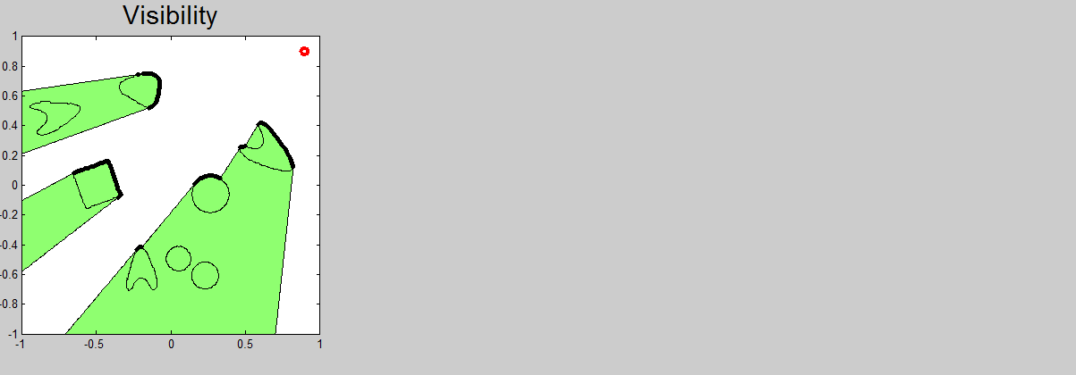
Entropy-seeking Exploration with Ising-Model Priors

Slide 3
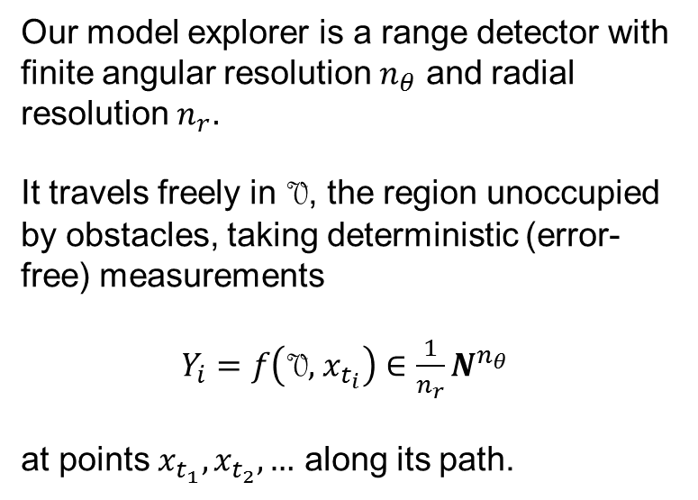
Explorer Model
Our model explorer is a range detector with finite angular resolution $n_{θ}$ and radial resolution $n_{r}.$
It travels freely in V, the region unoccupied by obstacles, taking deterministic (error-free) measurements
${Y_{i}=f\left(\text{V}, { x}_{t_{i}}\right)∈\frac{1}{n_{r}}N}^{n_{θ}}$
at points $x_{t_{1}},x_{t_{2}},…$ along its path.

Slide 4
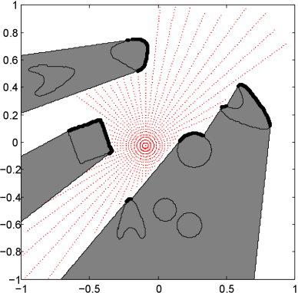
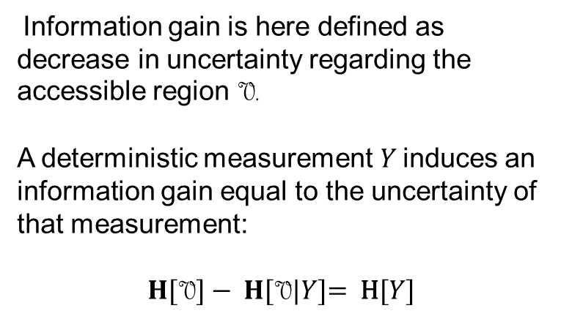
Information Gathering
Information gain is here defined as decrease in uncertainty regarding the accessible region V.
A deterministic measurement$Y$ induces an information gain equal to the uncertainty of that measurement:
$$H\text{[}\text{V}\text{]} \text{− }H\text{[}\text{V}\text{|}Y\text{]}\text{= }\text{H}\text{[}Y\text{]}$$

Slide 5
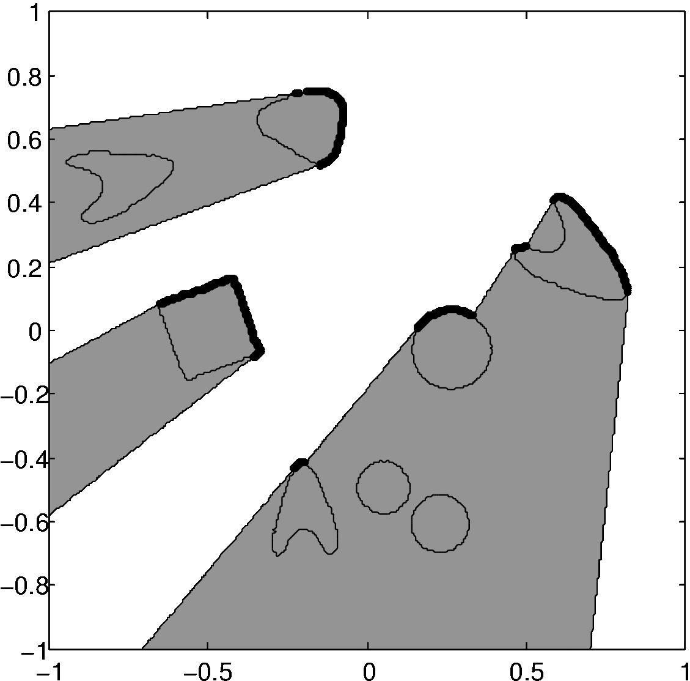
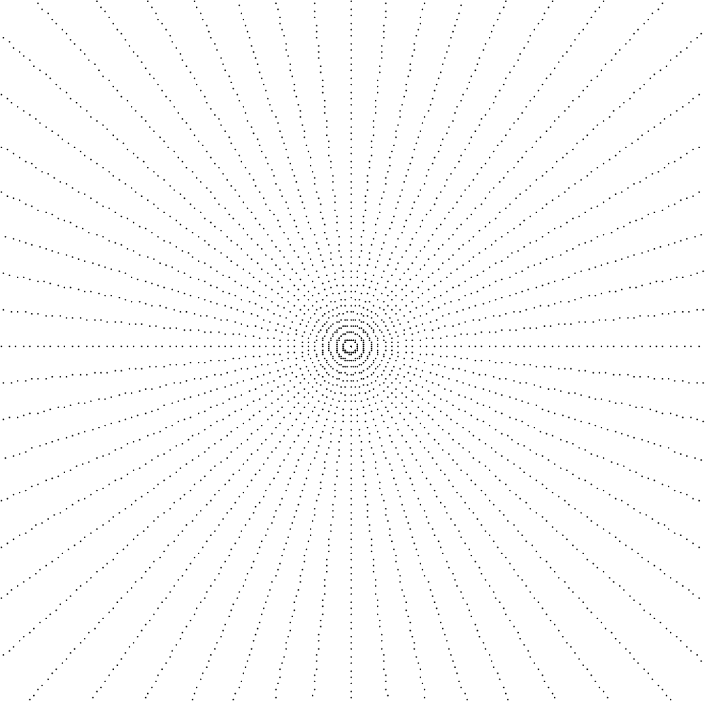
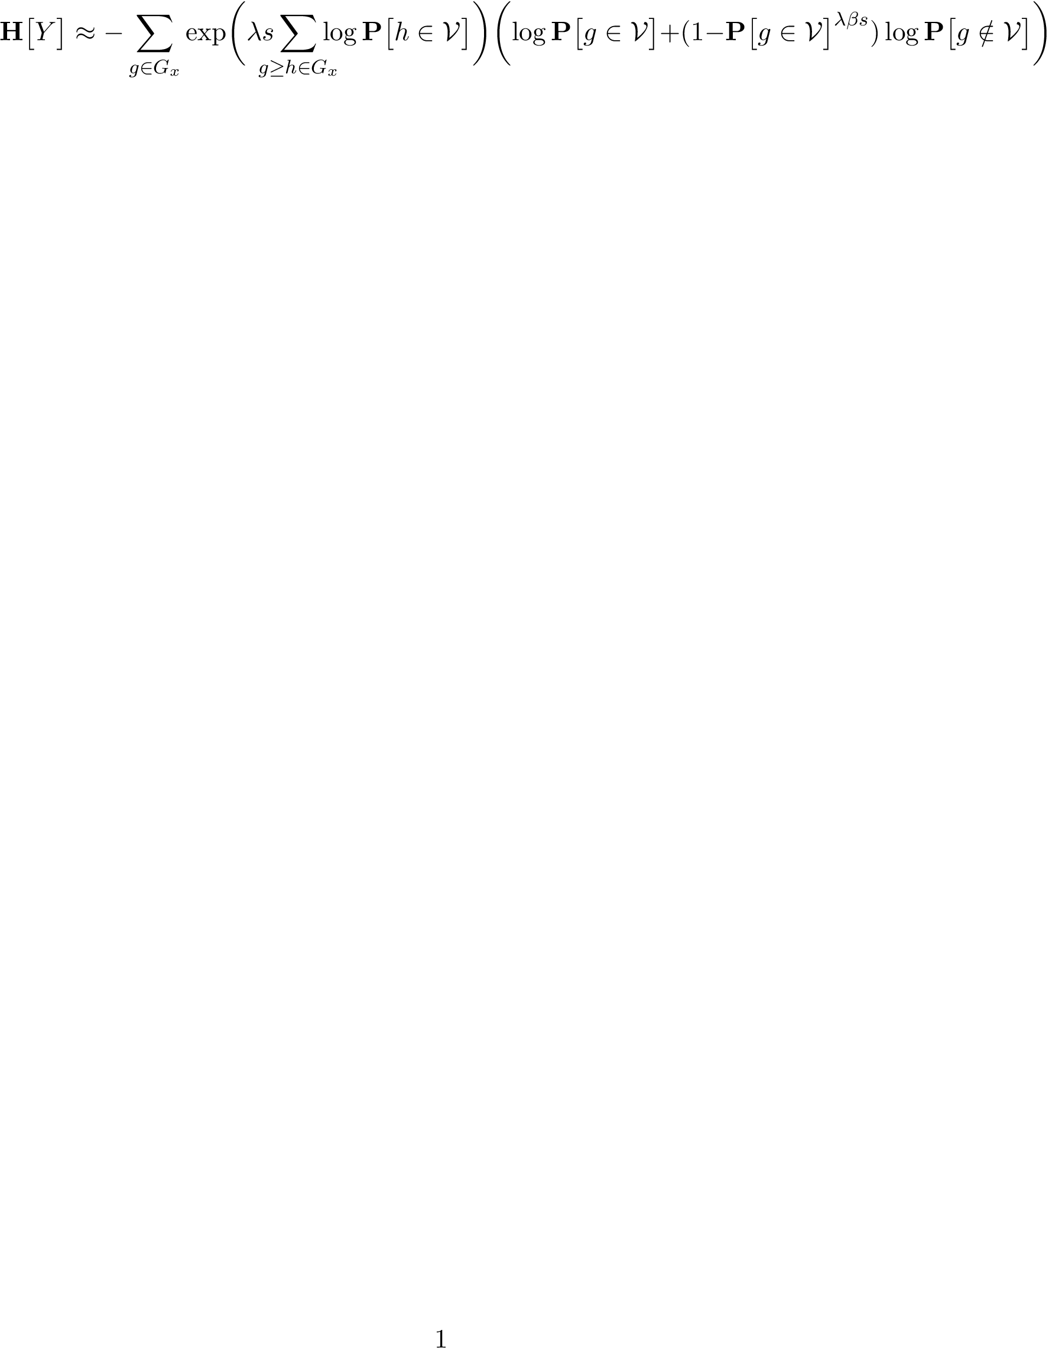
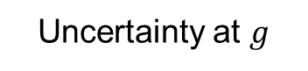
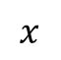
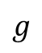
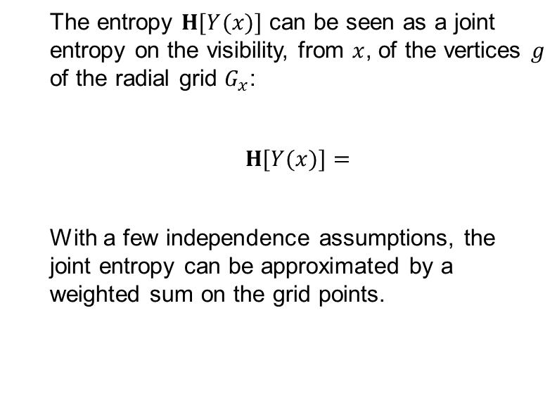
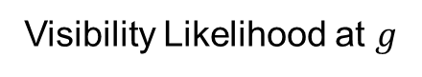
Calculating Next-View Entropy
The entropy $H\text{[}Y(x)]$ can be seen as a joint entropy on the visibility, from $x$, of the vertices $g$ of the radial grid $G_{x}$:
$H\text{[}Y(x)]=$
With a few independence assumptions, the joint entropy can be approximated by a weighted sum on the grid points.
$$g$$
$$x$$
Visibility Likelihood at $g$
Uncertainty at $g$

Slide 6
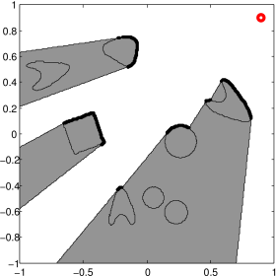
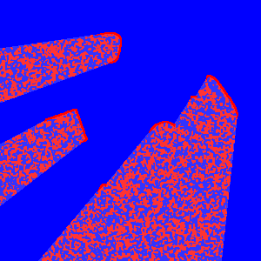
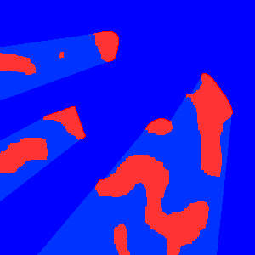
Ising Model Prior (Gibbs Sampling)
Partially-Revealed Scene
Compatible Ising Scene
Marginal Probabilities

Slide 7
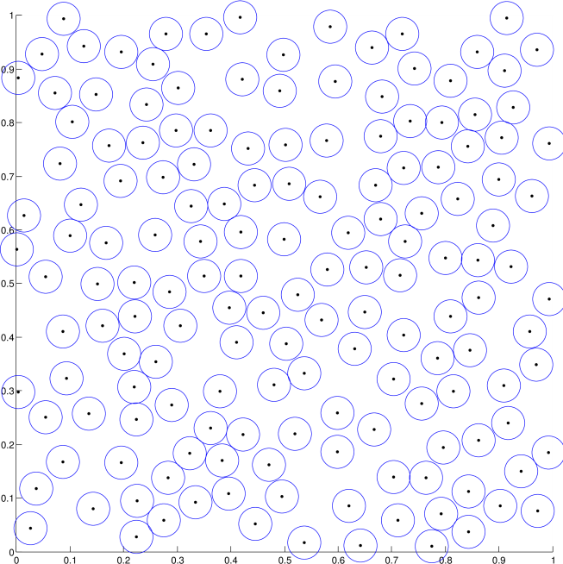
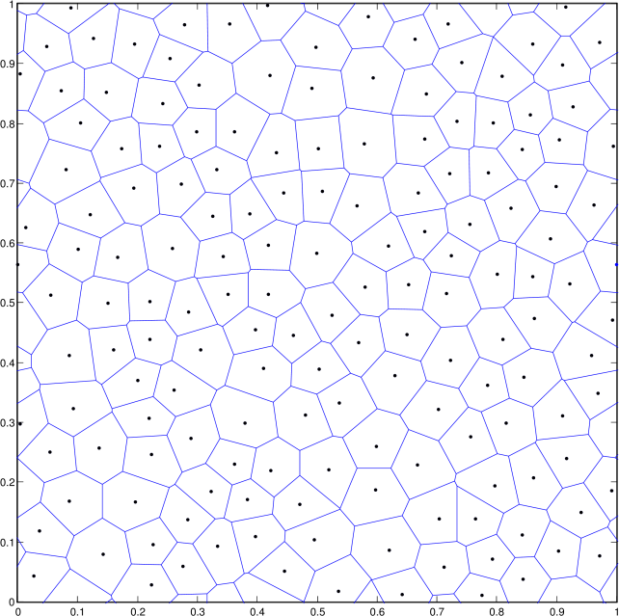
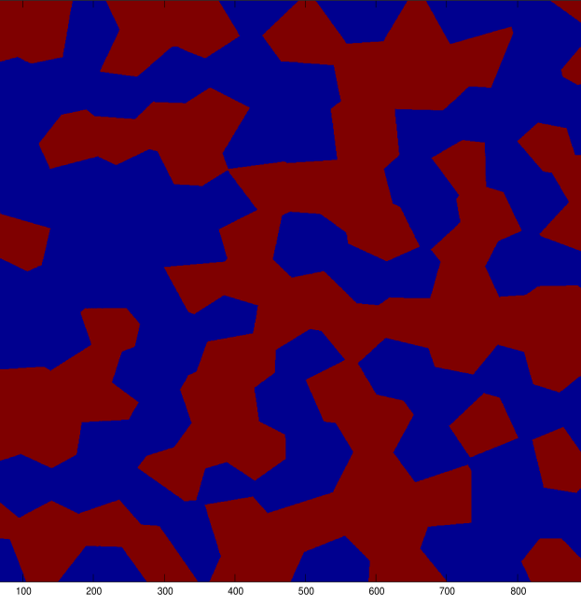
Poisson-Voronoi Approximation
Poisson-Disk Sampling
Poisson-Voronoi Partition
Random Checkerboard
Notes:
First pause: A Poisson-Disk sampling is the result of a random process which produces independent, uniformly random samples

Slide 8
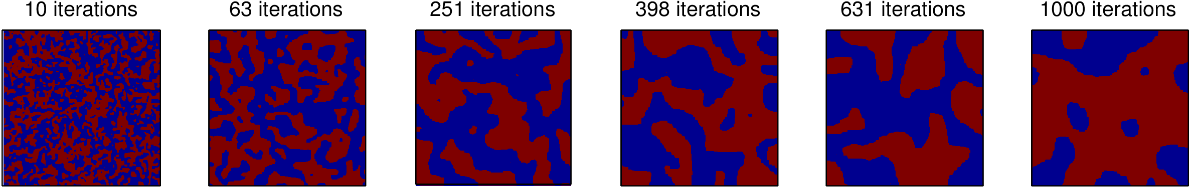
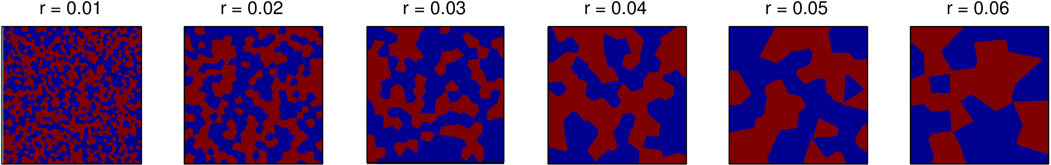
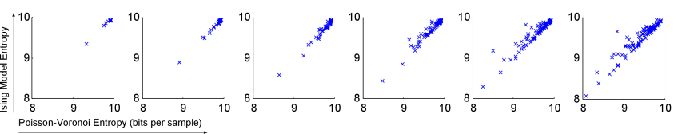
Poisson-Voronoi Approximation, cont’d
Ising Model
≈
≈
≈
≈
≈
≈
Poisson-Voronoi

Slide 9
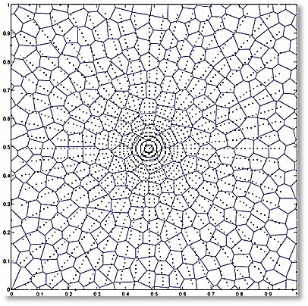
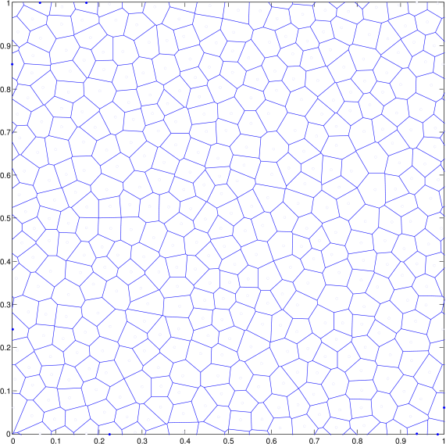
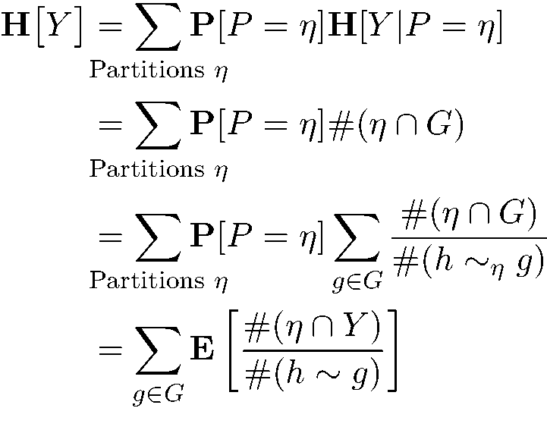
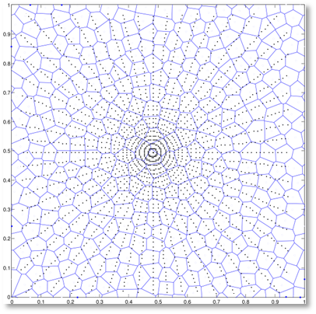
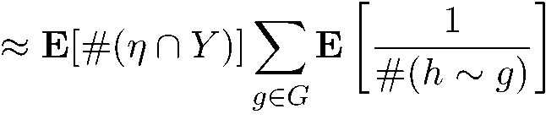
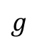
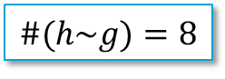
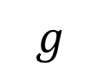
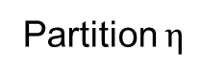
Computing Weights w_{g}
Partition $η$
$$g$$
$$g$$
$$\#(h\sim g)=8$$

Slide 10
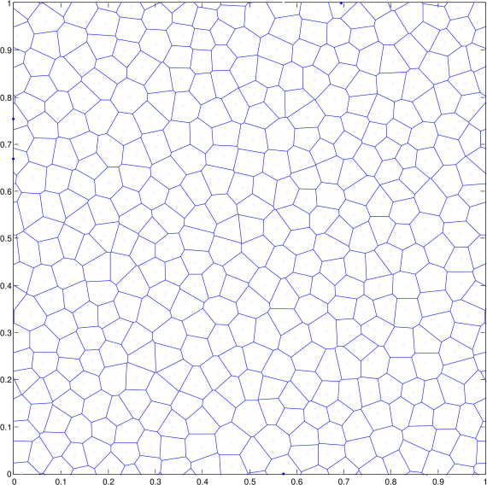
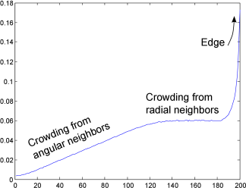
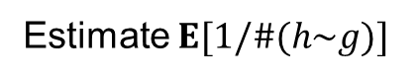
Computing Weights w_{g}
Estimate $E[1/\#(h\sim g)]$
Gain profile, r = 0.02
Gain (bits per sample)
Sample Index

Slide 11
Sufficient Exploration
out of range
too-oblique view

Slide 12
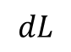
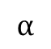
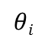
Sufficient Exploration 2
$$α$$
$$θi$$
$$dL$$

Slide 13
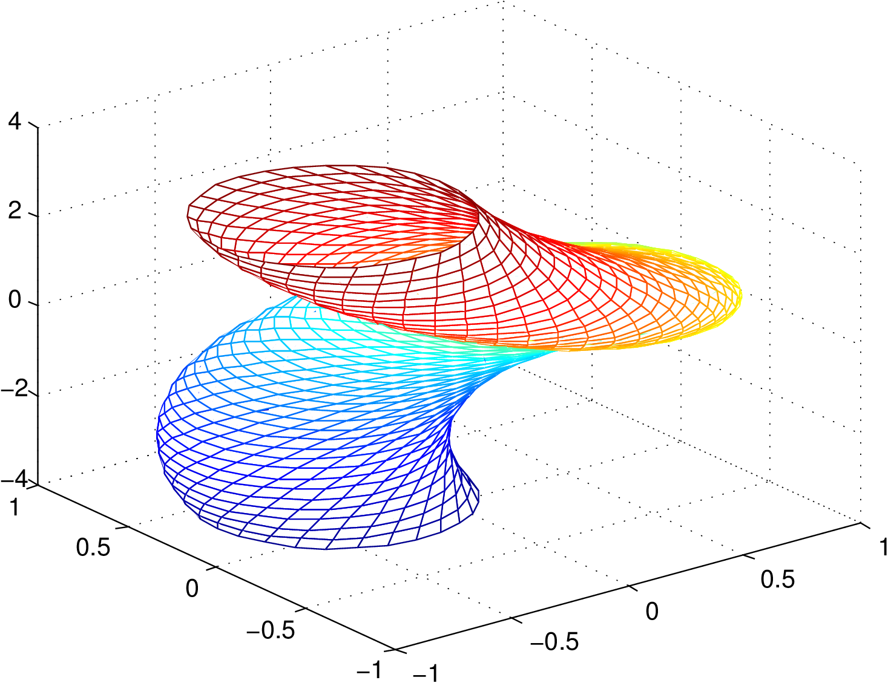
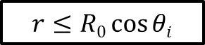
Sufficient Exploration 2
$$r≤R0\cos{θi}$$
Surfaces that pass within the “view screw” have been sufficiently explored.
Surface Normal (rads)

Slide 14
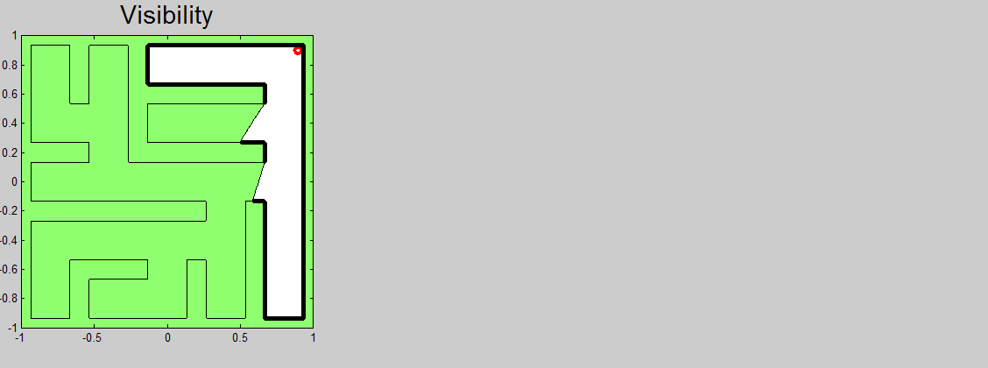
Extension: Far-Sighted Exploration

Slide 15
Extension: 3d Exploration
Extension of the algorithm to 3D is trivial.
Ising Model is defined on a generic lattice
Time is the biggest issue
Gibbs-Sampling step accounts for most of that – need a way to compute marginals without averaging.

Slide 16
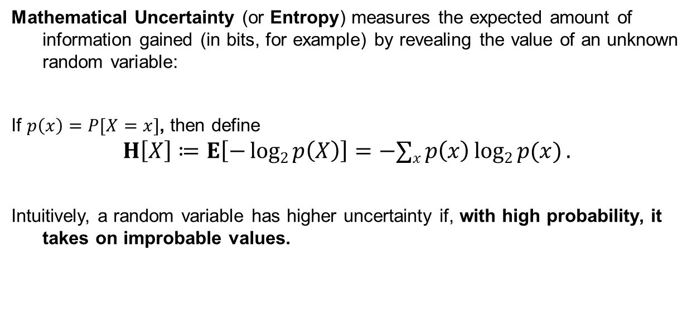
A Primer on Mathematical Uncertainty
Mathematical Uncertainty (or Entropy) measures the expected amount of information gained (in bits, for example) by revealing the value of an unknown random variable:
If $p\left(x\right)=P[X=x]$, then define
$$H\left[X\right]≔E\left[−log2{p\left(X\right)}\right]=−∑x p\left(x\right)log2{p(x)}.$$
Intuitively, a random variable has higher uncertainty if, with high probability, it takes on improbable values.

Slide 17
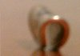
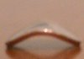
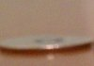
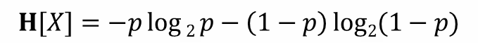
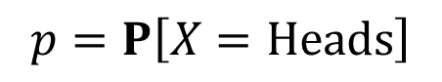
A Primer on Mathematical Uncertainty, cont’d
$$H[X]=−p\log{2 p}−\left(1−p\right)log2{(1−p})$$
Uncertainty (bits)
Coin images from
http://izbicki.me/blog/how-to-create-an-unfair-coin-and-prove-it-with-math
$$p=P\left[X=Heads\right]$$

Slide 18
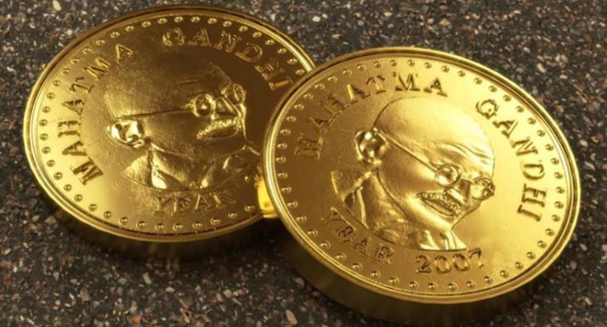
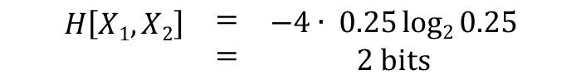
Joint Uncertainty
 | Heads | Tails
Heads | 0.25 | 0.25
Tails | 0.25 | 0.25
Two coins, No Correlation
$$\begin{matrix}\begin{aligned}H\left[X1, X2\right] \\ \end{aligned} & \begin{aligned}= \\ =\end{aligned} & \begin{aligned}−4∙ 0.25log2{0.25} \\ 2 bits\end{aligned}\end{matrix}$$

Slide 19
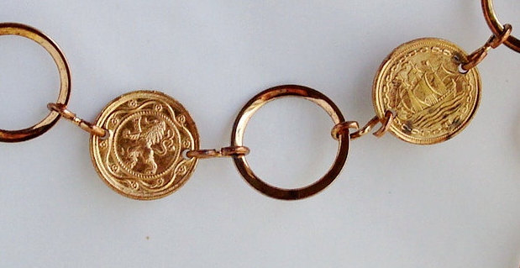
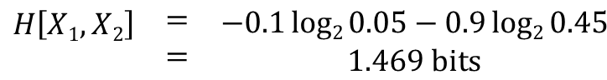
Joint Uncertainty, cont’d
 | Heads | Tails
Heads | 0.45 | 0.05
Tails | 0.05 | 0.45
Two Coins, High Correlation
$$\begin{matrix}\begin{aligned}H\left[X1, X2\right] \\ \end{aligned} & \begin{aligned}= \\ =\end{aligned} & \begin{aligned}−0.1log2{0.05}−0.9log2{0.45} \\ 1.469 bits\end{aligned}\end{matrix}$$

